Slide 1
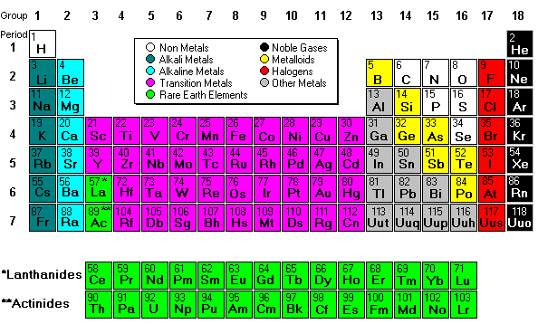
Unit 3:The Periodic Table
Jessica
&
Ryann

Slide 2
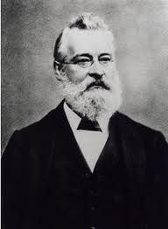
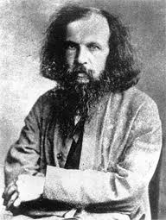
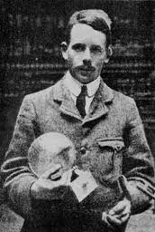
Who?
John Newlands
He create the law of Octaves'
Every 8th elements behaves similarly.
Dmitri Mendeleev
Organize elements into table.
Predicted unknown elements.
Henry Moseley
Organized based on atomic #, not mass

Slide 3
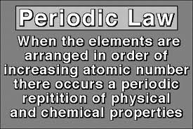
Periodic Law
States that: that the properties of elements are periodic functions of the elements’ atomic numbers.
Which means: When arranged by atomic number it has similar properties and regular intervals

Slide 4
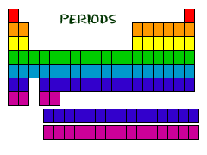
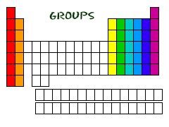
Rows & Columns
The Rows of a periodic table are called Periods
The Columns of the periodic table are called Groups
Main group elements:
Alkali Metals (group1)
1 valence electron
Alkali-Earth Metals (group2)
2 valence electrons
Halogens (group 17)
7 valence electrons
Noble Gases (group 18)
8 valence electrons
Hydrogen* (most common element)
1 valence electron
*Hydrogen is a class by itself

Slide 5
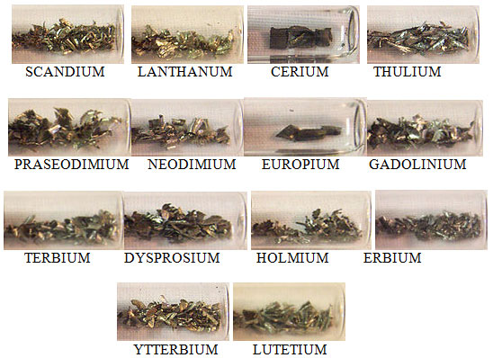
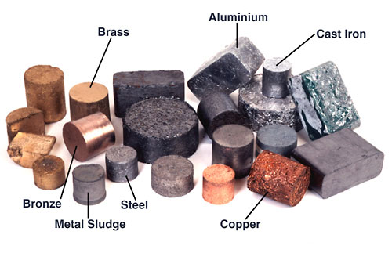
Metals:
Properties of Metals-
Conductors of electricity & heat
Ductile (can be pulled into a wire easily)
Malleable (can be flattened into a sheet easily)
Alloys: are a mixture of elements- Examples of alloys would be- jeweler, brass, and steel

Slide 6
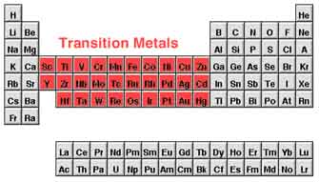
Transition Metals
Transition metals are in groups 3-12
They are d-block

Slide 7
Periodic Trends
Electron Shielding-inner electrons are much more attracted to nucleus than outer
Property/ Trend | Definition | Down | Right(Across)
Ionization of Energy | Energy to Remove electron | Electron shielding -> Decrease | Increased attraction Nucleus/electron -> Increase
Atomic Radius | Distance from nucleus to edge of atom | More energy levels -> increase | ↑ Attraction -> Decrease
Electro -negativity | When bonded, how much atom attracts electron | Decrease (electron shielding) | Increase (complete valence electron)
Melting & Boiling Points | Solid -> Liquid Temp Liquid-> Gas Temp |  | Increase 1st, Decrease

Slide 8
Elements: Natural & Synthetic
Natural Elements
93 elements were naturally formed in the interior of stars
Created by fusion reaction
H can be combined to create He
H can be considered the “building block” for all elements
Synthetic elements
were made by using particle accelerators

Slide 9
Transmutation:
Definition: Changing of one element into another
Alchemists wanted to transmute common metals into gold
Is possible but cost is more than gold
Not a chemical change but a nuclear change

