Slide 1
The Periodic Table
Kelsi L., Kristin Y. & Karla S.

Slide 2
What Would You Like To Review?
Contributors of the Periodic Table
Transmutation
Nuclear Reactions
Synthetic Elements
Element Trends
Periods
Natural Elements
Elements on the Periodic Table
Groups and Periods

Slide 3
Famous Dead People
Henry Moseley
Organized elements based on atomic #, not atomic mass
John Newlands
Law of Octaves
Every eighth element behaves similarly
Dmitri Mendeleev
Organized elements into a table
Predicted unknown elements

Slide 4
How does the Periodic Table Work?
Three ways:
Groups, Periods & Valence Electrons
Groups:
Are vertical columns
Periods:
The horizontal Rows

Slide 5
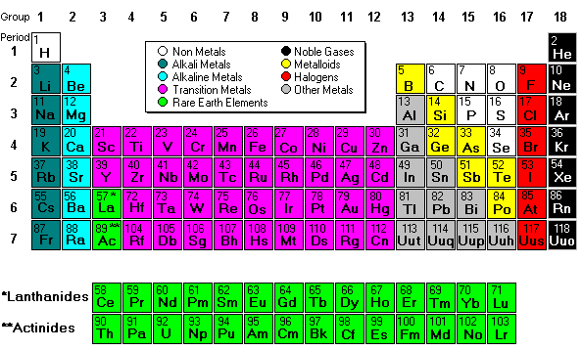
Periodic Table

Slide 6
Types of Elements
Hydrogen
Alkali Metals
Alkaline-Earth Metals
Lanthanoids and Actinoids
Halogens
Noble Gases
Transition Metals
Metals
To See Where Each Is On
The Periodic Table, click here.

Slide 7
Alkali Metals
What are they?
Group 1
1 Valence electron (s orbital has 1 electron)
React very, very violently
Metal
Alkali Metals
(Lithium, Sodium , Potassium, Rb, Cs, Francium)

Slide 8
Alkaline-Earth Metals
What are they?
Group 2
Has 2 valence electrons (s orbital has 2 electrons)
Very reactive
Act as readily as Alkai
Alkaline- Earth:
Be, Mg, Ca, Sr, Ba, Ra

Slide 9
Halogens
What is a Halogen?
Group 17
7 Valence electrons
Most reactive of non-metals
Greek name means Salt & Creator
Halogens:
Cf, Cl, Br, I, Al

Slide 10
Noble Gases
What are “Noble Gases”?
Group 18
8 valence electrons [Full]
Very unreactive
“Inert Gases”
Noble Gases
H, Ne, Ar, Kr, Xe, Ra

Slide 11
Hydrogen
What is Hydrogen?
Most common in the universe
1 valence electron
Reacts w/ many elements
Hydrogen is Hydrogen

Slide 12
Metals
Properties
Excellent conductors of electricity and heat
Ductile- can be pulled into a wire easily
Malleable- can be flattened into a sheet easily
Alloys
Mix of elements
Ex. Ring (jewelry)
Ex: Brass: copper and zinc
Ex: Steel

Slide 13
Transition Metals
What is a Transition Metal?
Groups 3-12
D-block (fills d-orbitals)
1 Electron in D orbital
Good Catalysts

Slide 14
Lanthanides & Actinides
What are they?
F-block (fill f-orbitals)
Lanthanides- shiny, similar to Alkali-Earth metals
Actinides-radioactive
Nucleus is large, therefore it is unstable

Slide 15
Periods
Definition:
All elements in the same period have SAME # of occupied energy levels & SAME # of Valence electrons
-Where is it located?
On the vertical column of the Periodic Table

Slide 16
Periodic Trends
Name | Definition | Going Down | Going Across (Right)
Ionization energy | What energy it takes to remove (lose) an electron | Decreases (goes down) as you move down (electron shielding) | Increases as you move right)
Atomic radius (Bond radius) | ½ distance of 2 nuclei of the same element bonded together | More energy levels means that -> increases | Attraction -> decrease
Electronegativity | When bonded, how much atom attracts electron | Decreases (electron shielding) | Increases (complete valence electrons)
Melting point | Solid -> liquid temp. |  | “Peaks” increases then decreases
Boiling point | Liquid -> Gas Temp. |  | “Peaks” increases then decreases

Slide 17
Natural Elements
A natural Element is. . . . .
93 elements- some were found in outerspace
Definition- Elements that occurs in nature
Created by a fusion reaction
It can be combined to create Helium
It can be considered the “Building Block” for all elements

Slide 18
Nuclear Reactions
A Nuclear Reaction
Ex: Fusion in the sun
4 H combined to make He
2p -> 2p
2p-> 2n + energy
E=mc²
2 He can be combined to form something else
Fission: Splitting of an atom

Slide 19
Transmutation
Definition:
Changing of one element to another
Alchemists wanted to transmutate common metals into gold
Can do this, but cost of doing it is more than gold.
Not a chem. Change, nuclear change

Slide 20
Synthetic Elements
They are . . . . . . . . . .
MAN MADE.
The last elements from 93-103
Use particle accelerator to make

Slide 21
The End! Good Luck!

